Slide 1
ONLINE rETAILER – ml APPROACH TO cUSTOMERS & INSIGHTS
Arunkumar Rajaganpathy
Neha Pandey

Slide 2
AGENDA
Introduction
Problem Statement
Data Preprocessing
Classification and Clustering
Conclusion

Slide 3
Problem Statement
The primary goal of this project is to derive insights on UK based online retail organization data set(Daqing Chen. (2012).). These insights include customer segmentation, identifying high value customers, segretating high and low sales regions and implementing clustering to identify stock requirement to seasonality.

Slide 4
Objective
This project aims to develop an AI-based classification system for an online retail platform to improve user engagement and sales. Using classification, the project intends to classify high value items, customer trends and regions with sales value. It provides insights into data by seasonality , regions and customer interests. It aims to find segmen

Slide 5
Data Preprocessing
In order to refine the data to present correct insights on retail data Daqing Chen. (2012).
Removed columns which didn’t have significance in classification – Short description
Added total value column to analyze sales across regions
Converted Invoice date to month, time and year for seasonal analysis
Analyzed data on unique customers and unique transactions

Slide 6
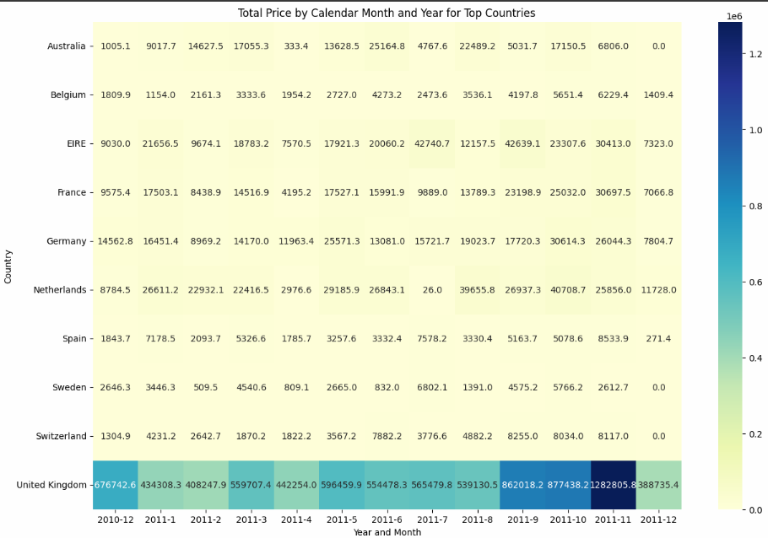
Heatmap of EDA by Total Price
Total Price = Quantity * Price

Slide 7
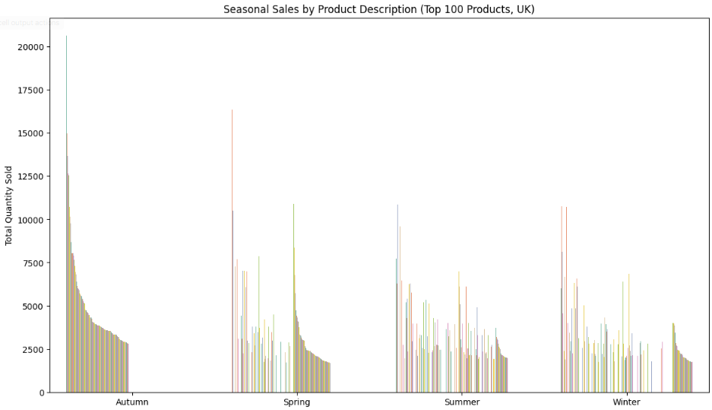
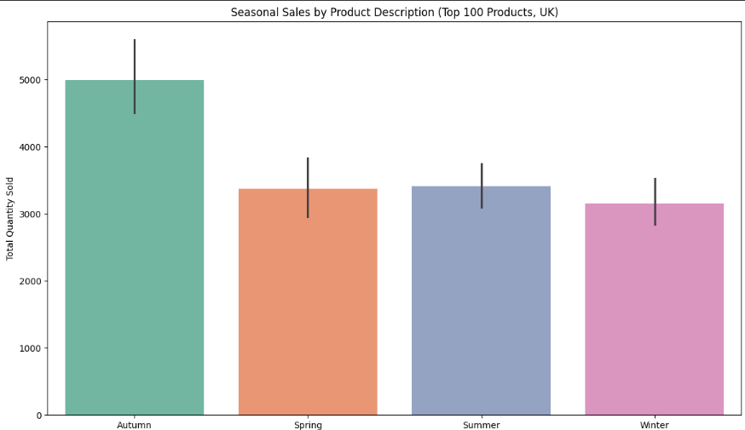
SEASONLITY

Slide 8
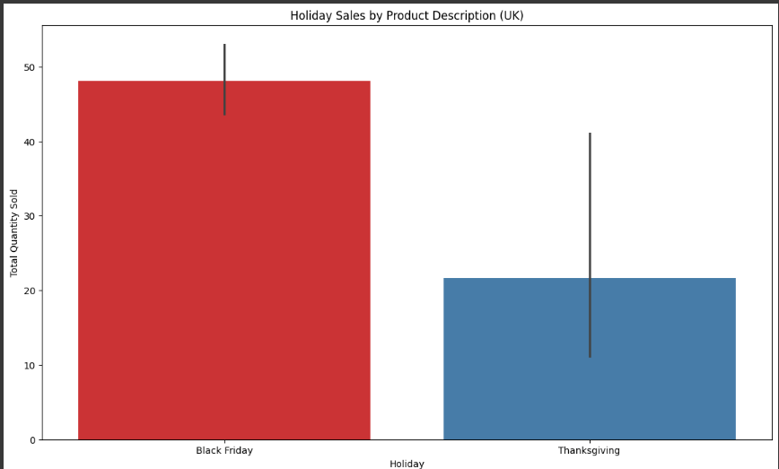
HOLIDAY SALES BY

Slide 9
Seasonality – Analysis & Next Steps
Based on seasons sale, we can predict and forecast inventory required.

Slide 10
Classification
This project aimed to classify high-value orders from an online retail dataset based on features like product quantity, price, and customer location. Five machine learning models were trained and evaluated to determine the best-performing algorithm. We filtered customers based on recency , frequency and monetary basis and executed following classification models
Customer Segmentation :
Based on the above inference., on the Heatmap, restricting the dataset with Country ='United Kingdom'
Metrics
Recency (days since last purchase)'
'Frequency (number of purchases)'
Monetary (total spent in $ /Pound)
Random Forest Classifier:
Ensemble method combining decision trees for robust performance.
Strength: Handles high-dimensional data and provides feature importance.
Accuracy: 99%

Slide 11
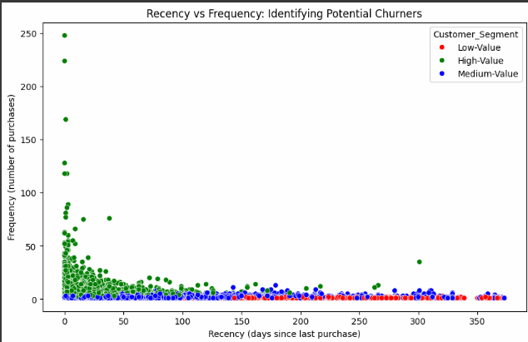
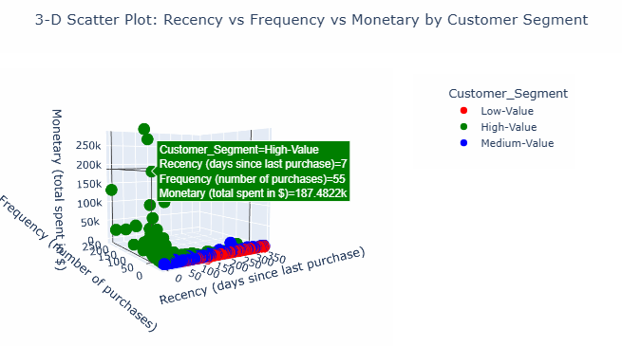
Customer Segmentation

Slide 12
Classification
Support Vector Machine (SVM):
Finds the optimal hyperplane for classification.
Strength: Effective for smaller datasets with a clear margin of separation.
Accuracy: 97.1%
Gradient Boosting Classifier:
Boosting technique focusing on minimizing errors iteratively.
Strength: Highly accurate and efficient for structured data.
Accuracy: 99.6%
K-Nearest Neighbors (KNN):
Classifies based on the majority vote of nearest neighbors.
Strength: Simple and intuitive.
Accuracy: 97.6%
Logistic Regression:
Linear model for binary classification.
Strength: Easy to interpret and suitable for smaller feature sets.
Accuracy: 96.4%

Slide 13
Classification
S.No | Model | Accuracy | MCC | F1 Score | TP Rate | TN Rate | ROC AUC
1 | Random Forest | 0.996571 | 0.992791 | 0.995595 | 0.994135 | 0.998127 | 0.999967
2 | Decision Tree | 0.994286 | 0.988032 | 0.992701 | 0.997067 | 0.992509 | 0.994788
3 | Gradient Boosting | 0.996571 | 0.992807 | 0.995582 | 0.991202 | 1 | 0.999995
4 | Logistic Regression | 0.964571 | 0.925381 | 0.953938 | 0.941349 | 0.979401 | 0.993410
5 | Naive Bayes | 0.881143 | 0.759503 | 0.822526 | 0.706745 | 0.992509 | 0.988467
6 | SVM (Radial) | 0.969143 | 0.935025 | 0.960118 | 0.953079 | 0.979401 | 0.994964
7 | SVM (Linear) | 0.971429 | 0.939906 | 0.963289 | 0.961877 | 0.977528 | 0.993904
8 | K-Nearest Neighbors | 0.976 | 0.94949 | 0.969072 | 0.964809 | 0.983146 | 0.998622

Slide 14
Customer Segmentation
Please utilize the Py script for 3-D Analysis

Slide 15
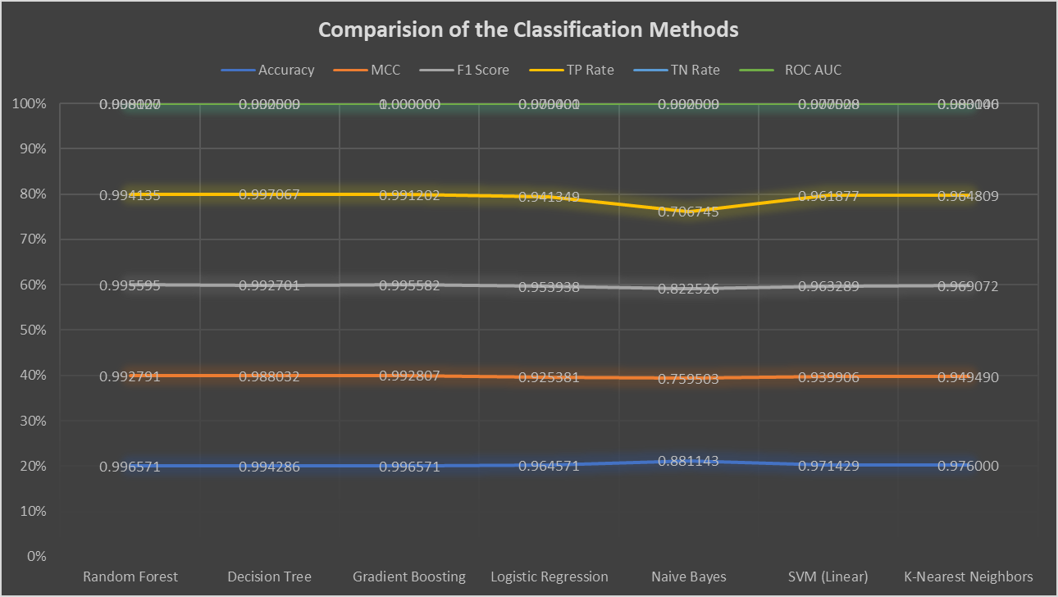
Classification - Feature Ranking

Slide 16
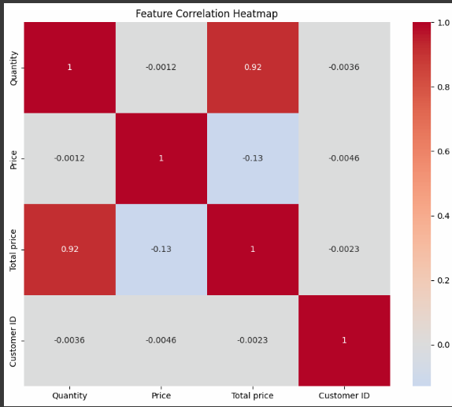
Feature Co-relation Map

Slide 17
Classification – Analysis & Next Steps
Based on classification performed we can classify
High value customers
Identify high and low selling regions
Extend the model to identify potential churners
Classify seasonal sales

Slide 18
Clustering
Unsupervised learning
Clustering enables unsupervised learning .In the current problem statement we are leveraging clustering to enable the model for following
Customer Segmentation:
Group customers by behavior (e.g., purchase patterns, demographics).
Example: Identify high-value customers.
Stock Prediction
Divide stocks into clusters for actionable steps
Types of clustering
K-NN
Assign each record to the nearest cluster mean as measured by squared distance.
Compute the new cluster means based on the assignment of records.
Key components
PCA (Principal Components)
Cluster analysis
Finds groups of records located near one another.
Elbow Method – Clusters with most variance of data

Slide 19
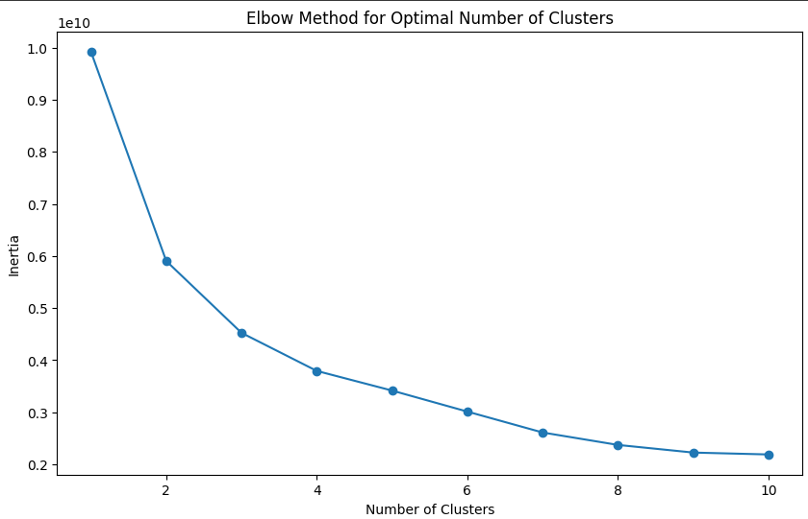
Clustering - Elbow Method for Optimal Clusters

Slide 20
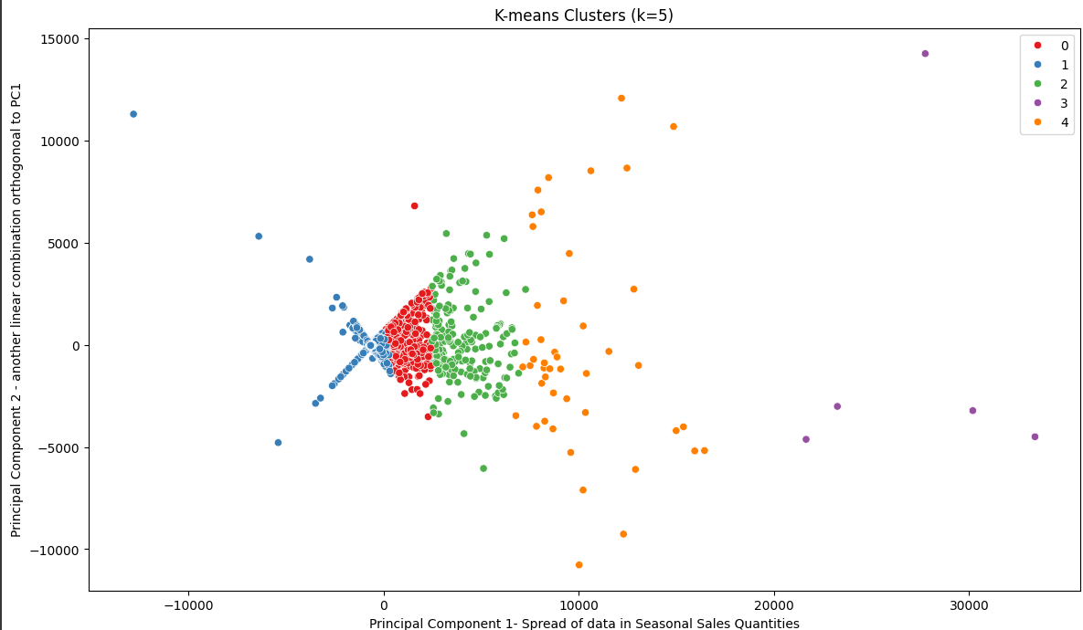
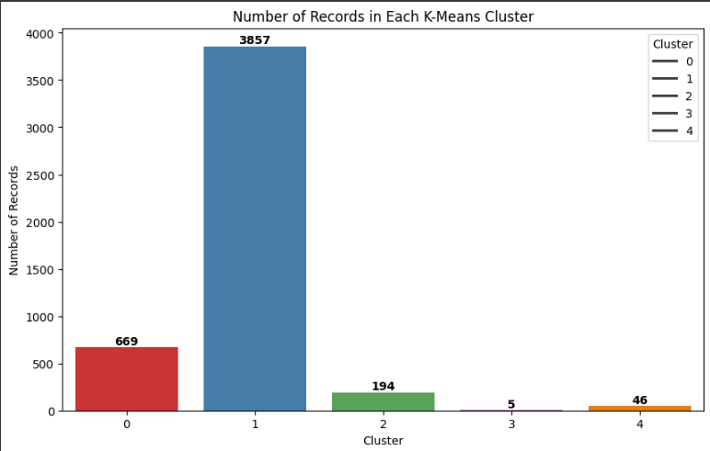
Clustering - Observations

Slide 21
Clustering - Observations

Slide 22
Clustering – Analysis & Next Steps
These Observations indicate the Stock Code can be clustered based on different segments
Seasonality and the Quantities
Top products to be stocked in-terms of
Inventory management
Demand prediction
Efficient marketing campaign &
Promotion Planning

Slide 23
Appendix

Slide 24
Classification - Feature Ranking
S.No | Model | Accuracy | MCC | F1 Score | TP Rate | TN Rate | ROC AUC
1 | Random Forest | 0.996571 | 0.992791 | 0.995595 | 0.994135 | 0.998127 | 0.999967
2 | Decision Tree | 0.994286 | 0.988032 | 0.992701 | 0.997067 | 0.992509 | 0.994788
3 | Gradient Boosting | 0.996571 | 0.992807 | 0.995582 | 0.991202 | 1 | 0.999995
4 | Logistic Regression | 0.964571 | 0.925381 | 0.953938 | 0.941349 | 0.979401 | 0.993410
5 | Naive Bayes | 0.881143 | 0.759503 | 0.822526 | 0.706745 | 0.992509 | 0.988467
6 | SVM (Linear) | 0.971429 | 0.939906 | 0.963289 | 0.961877 | 0.977528 | 0.993904
7 | K-Nearest Neighbors | 0.976 | 0.94949 | 0.969072 | 0.964809 | 0.983146 | 0.998622
Above Feature Ranking scores indicate that Random Forest Method has better accuracy, please refer Appendix for detailed descriptions on the insights of the Metrics

Slide 25
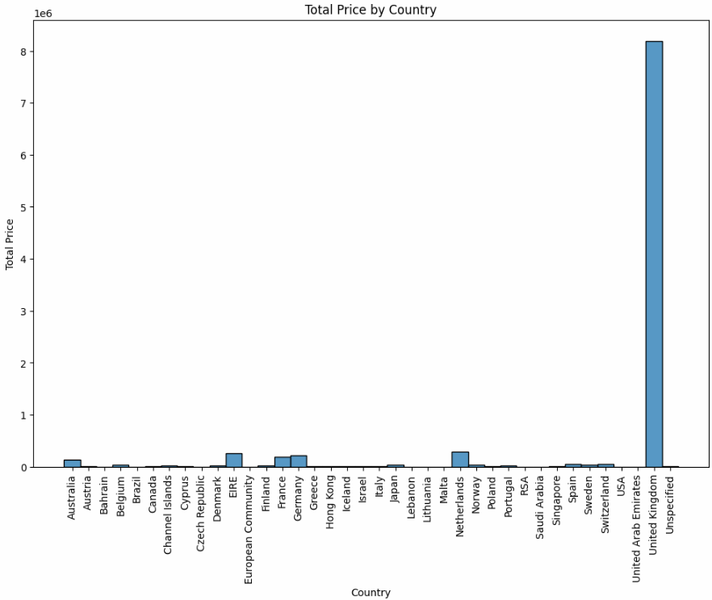
EDA (Exploratory Data Analysis)
Data split based on the Total price by Country
Total Price = Quantity * Price

Slide 26
Heatmap of EDA by Total Price
Total Price = Quantity * Price

Slide 27
Customer Segmentation
Based on the above inference., on the Heatmap, restricting the dataset with Country ='United Kingdom'
Metrics
Recency (days since last purchase)'
'Frequency (number of purchases)'
Monetary (total spent in $ /Pound)

Slide 28
Clustering
Unsupervised learning
K-NN
Assign each record to the nearest cluster mean as measured by squared distance.
Compute the new cluster means based on the assignment of records.
Key components
PCA (Principal Components)
cluster analysis
finds groups of records located near one another.
Elbow Method – Clusters with most variance of data
• Clusters are assumed to derive from different data-generating processes with different
probability distributions.
• Different models are fit, assuming different numbers of (typically normal) distributions.
The method chooses the model (and the associated number of clusters) that fits the data well without using too many parameters (i.e., overfitting).

Slide 29
Clustering - Elbow Method for Optimal Clusters

Slide 30
Clustering - Observations

Slide 31
Clustering - Observations

Slide 32
Conclusion – Revisit overall
These Observations indicate the Stock Code can be clustered based on different segments
Seasonality and the Quantities
Top products to be stocked in-terms of
Inventory management
Demand prediction
Efficient marketing campaign &
Promotion Planning

Slide 33
Abbreviations
MCC: Matthews correlation coefficient.
TP rate: true positive rate (sensitivity, recall). TN rate: true negative rate (specificify).
Confusion matrix threshold for MCC, F1 score,
accuracy,
TP rate, TN rate: τ = 0.5.
PR: precision-recall curve.
ROC: receiver operating characteristic curve.
AUC: area under the curve.
MCC: worst value = –1 and best value =+1.
F1 score, accuracy, TP rate, TN rate, PR AUC, ROC AUC: worst value = 0 and best value = 1. MCC, F1 score, accuracy, TP rate, TN rate, PR AUC, ROC AUC formulas: Additional

Slide 34
References
Dataset
Daqing Chen. (2012). Online Retail II [Dataset]. UCI Machine Learning Repository. https://doi.org/10.24432/C5CG6D

